Slide 1
Image Processing Path
Zero.lin

Slide 2
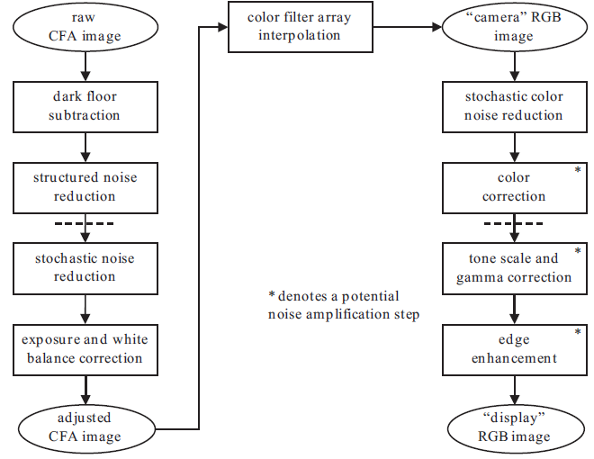
Chain and function match
AHD
Convert to rgb
scale
Write

Slide 3
Systematic Sensor Data Correction
Dark Floor Subtraction
Cause: thermal noise and other nonphoton-generated noise
Method: subtract a fixed value or a “lens cap” shot
In Dcraw: support both methods
Structured Noise Reduction
Cause: sensor is imperfect, defective pixels and variations in the thickness of the CFA color filters
Method: subtract a dark floor mask
In Dcraw: delete defective pixels

Slide 4
CFA Data Correction
Stochastic Noise Reduction
Method: low-pass filtering, sigma filtering and median filtering
In Dcraw: wavelet denoise
Note: if a system consists of a number of operations that are signal amplifiers, then it is best to reduce noise contributions as early as possible in the chain
Exposure and White Balance Correction
Cause: digital cameras cannot automatically adjusts the apparent exposure and white point
Method: user specify or automatic exposure and white balance correction
In Dcraw: specify or average a region pixels

Slide 5
Adjusted CFA Image and Image Data Calibration
Color Filter Array Interpolation
Stochastic Color Noise Reduction
Method: low-pass filtering, sigma filtering and median filtering
In Dcraw: median filtering
Note: It is far better to transform the image into a luminance-chrominance representation
Color Correction
Cause: prepare the image for its final rendered form
Method: transform the image into a standard calibrated color space
In Dcraw: support {sRGB, Adobe RGB (1998), WideGamut D65, ProPhoto D65, XYZ}

Slide 6
Image Space Rendering
Tone Scale and Gamma Correction
Cause: human visual system’s ability to adapt to a wide range of scene luminances
Method: point transform of the image data
In Dcraw: support
Edge Enhancement
Cause: make it look sharper
Method: direct convolution, unsharp masking
In Dcraw: no support

Slide 7
Conclusion
Dcraw has almost the same path as described path, except dcraw consider chromatic aberration the path doesn`t, the path consider edge enhancement which dcraw doesn`t involve.

Slide 8
Thanks

